Slide 1



ANATOMY OF THE FEMALE GENITAL SYSTEM
Dr Tampaki Ekaterini Christina, Plastic and Reconstructive Surgeon
Dr Filippou Dimitrios, Assistant Professor- General Surgeon
Dr Sinou Natalia, PhD candidate

Slide 2
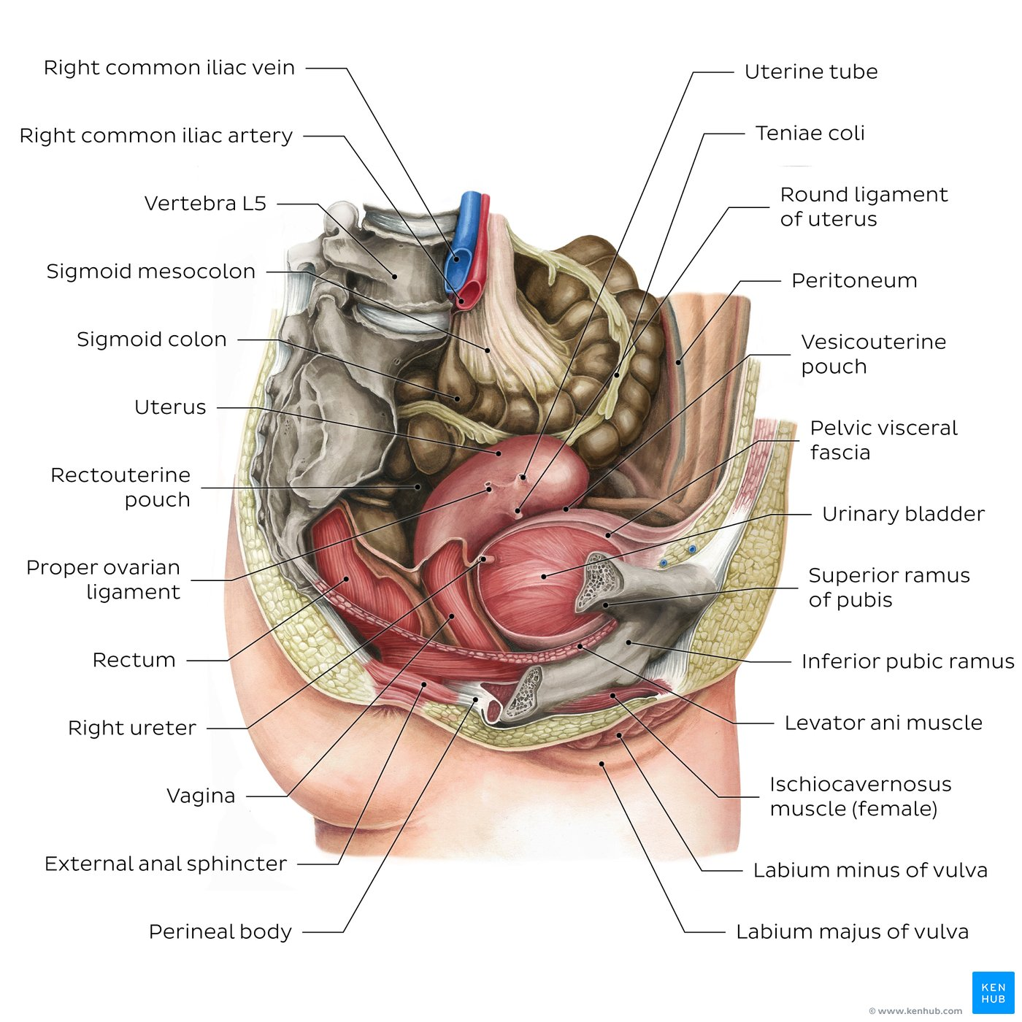
Female pelvic cavity and perineum

Slide 3
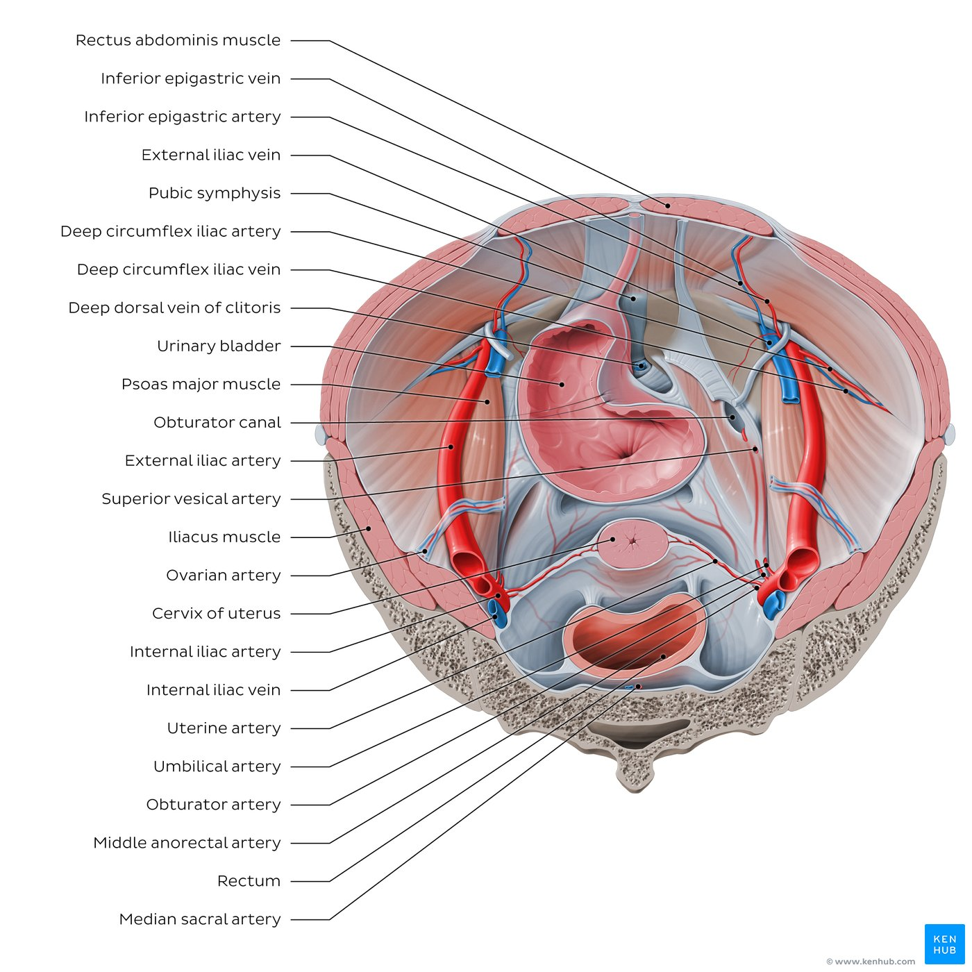
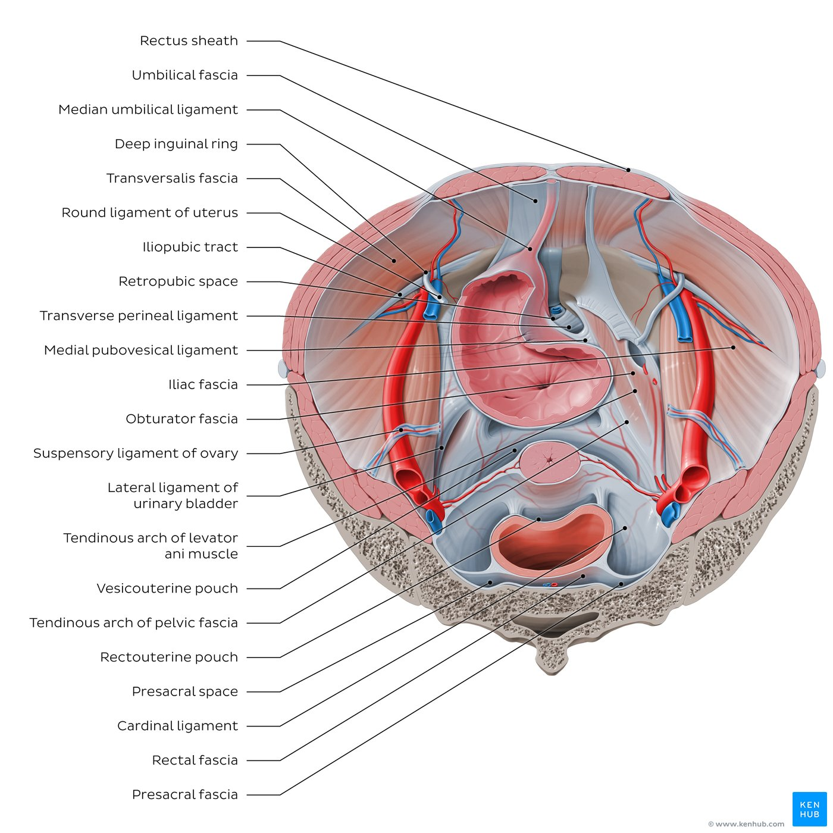
Organs and vessels of pelvic cavity, Fasciae/ligaments and anatomical spaces (superior view)

Slide 4
Key points about the female pelvic cavity
Walls and floors | Bones: Hip bone (Ilium, ischium, pubis), sacrum, coccyx Ligaments: Sacroiliac, sacrospinous, and sacrotuberous Muscles: Levator ani, coccygeus, piriformis, obturator internus
Digestive organs | Organs: Sigmoid colon, rectum Functions: Absorption of minerals, vitamins, water and electrolytes, temporary storage of fecal matter and elimination during defecation
Reproductive organs | Organs: Ovary, uterine tube, uterus, vagina Functions: Formation and development of ova, production of estrogen and progesterone, implantation of embryo, fetal development
Urinary organs | Organs: Pelvic part of ureter, urinary bladder Functions: Transport and elimination of urine from from the body
Peritoneal pouches/depressions | Vesicouterine pouch (between uterus and urinary bladder) Rectouterine pouch (between uterus and rectum) Pararectal fossae (lateral to rectum)
Blood supply | Internal iliac artery: Superior vesical arteries, inferior vesical artery, internal pudendal artery, middle [ano]rectal artery Superior [ano]rectal artery (from inferior mesenteric artery) Median sacral artery (from aortic bifurcation) Ovarian artery (from abdominal aorta)
Innervation | Sympathetic: Lumbar splanchnic nerves, hypogastric and pelvic plexuses Parasympathetic: Pelvic splanchnic nerves, left and right inferior hypogastric plexuses, and rectal (pelvic) plexus

Slide 5
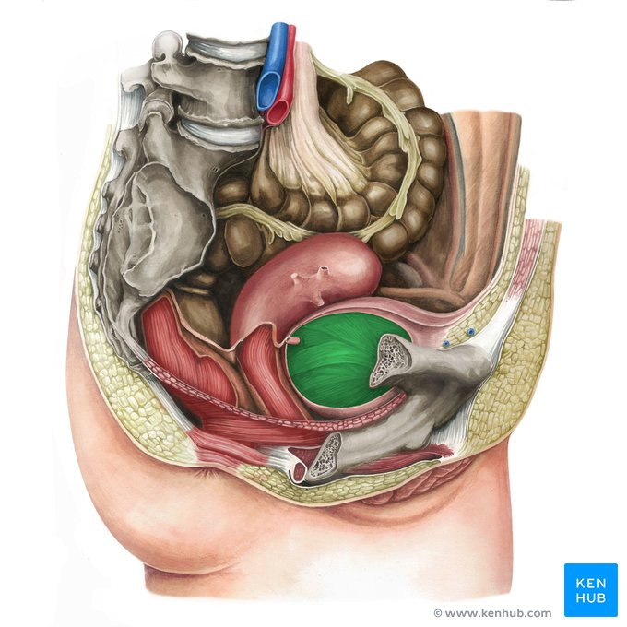
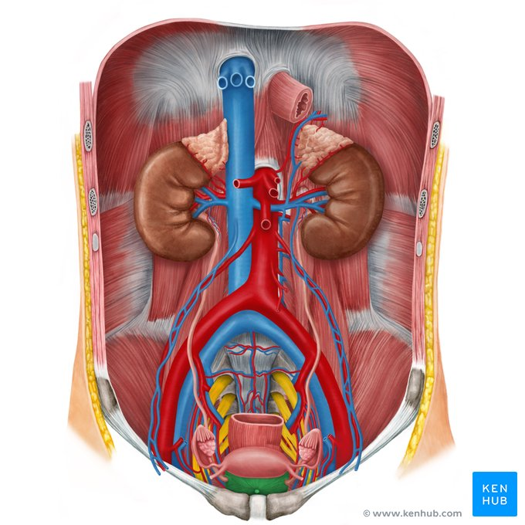
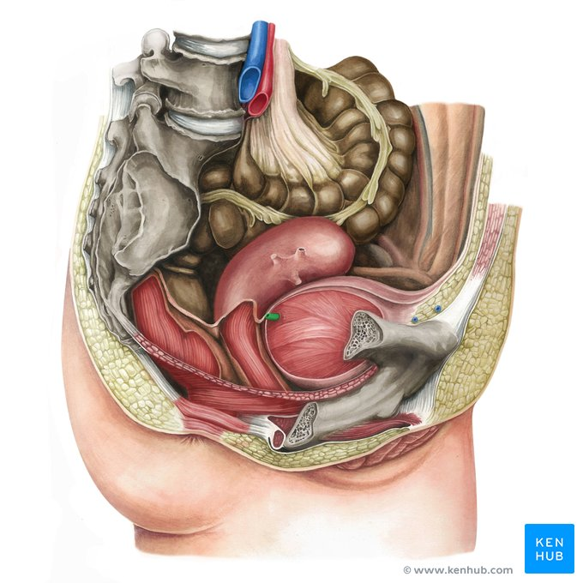
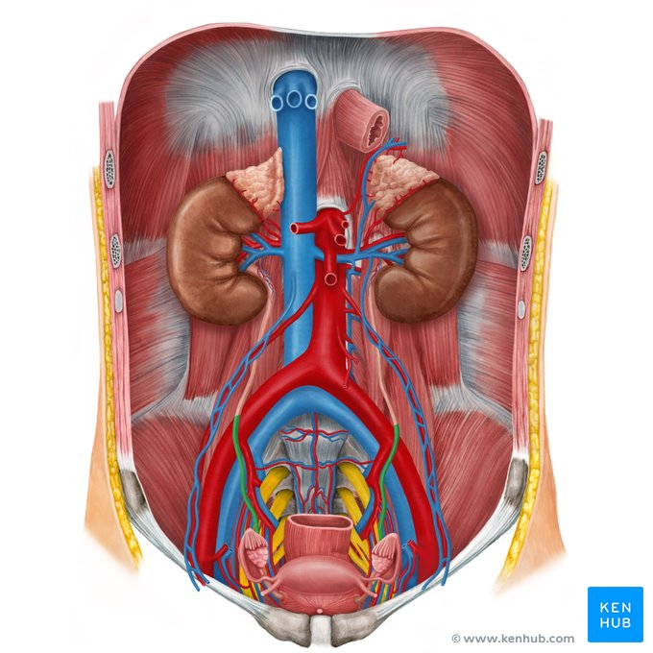

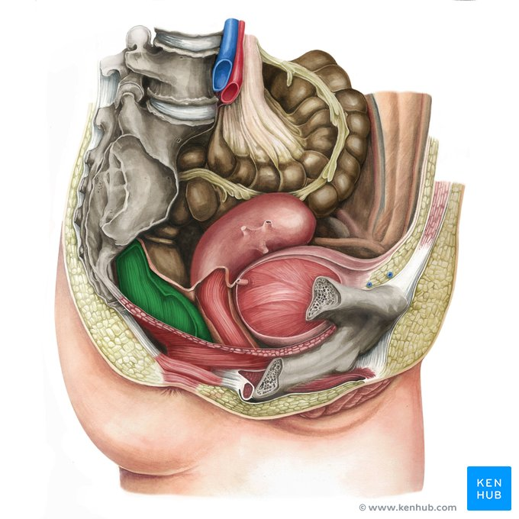
Urinary bladder, ureters, ovary, rectum

Slide 6
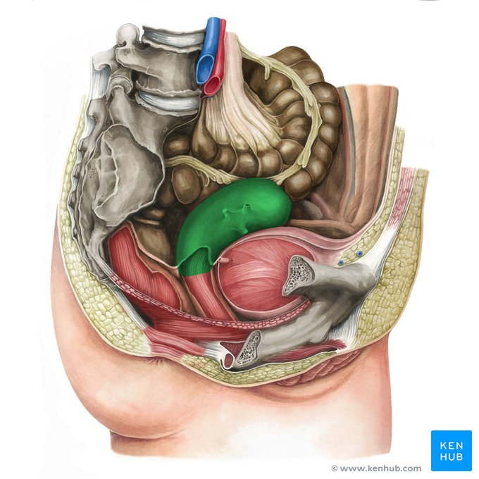
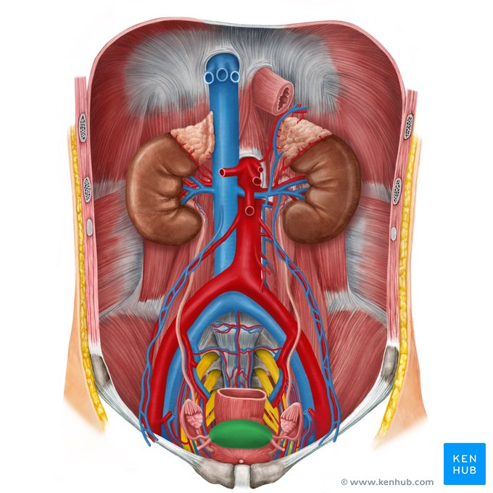


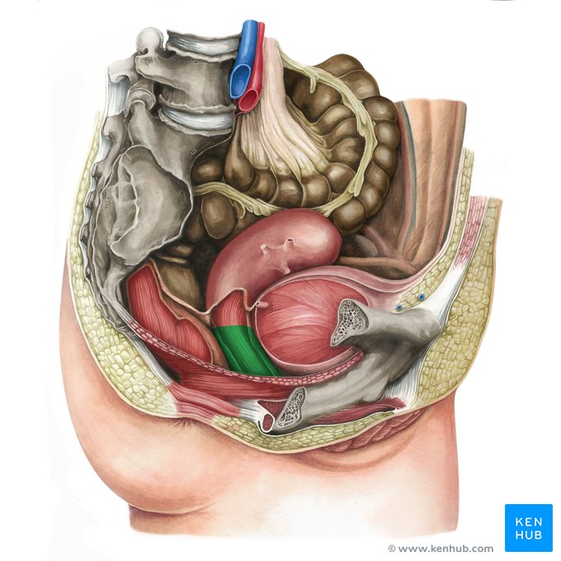
Uterus, round ligament of uterus, ovarian ligaments, vagina

Slide 7
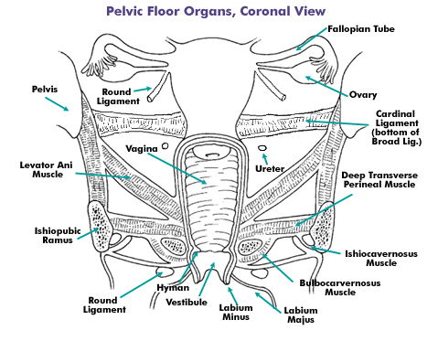
THE PELVIC FLOOR
All tissues lying between the pelvic cavity and the surface of the vulva and perineum.
Includes:
Pelvic peritoneum
Extraperitoneal fat and cellular tissue
Levators ani and their fascial coats
The triangular ligament (urogenital diaphragm)
The perineal muscles and their aponeuroses
Subcutaneous fascia and fat
Skin.

Slide 8
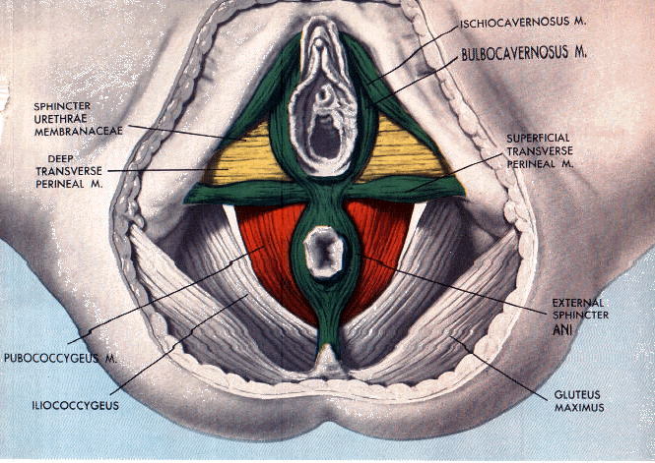
Pelvic Diaphragm
= The levator ani muscles
+ the fascia which covers their upper and lower surfaces
In the midline, the pelvic floor is pierced by the
Urethra
Vagina
Rectum.

Slide 9
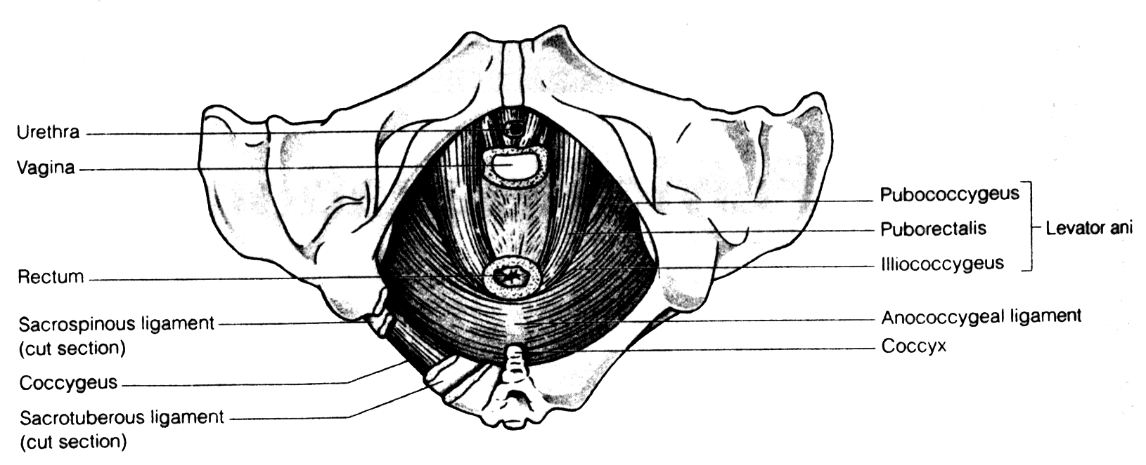
The Levator ani muscle
The ischiococcygeus part:
Origin from the ischial spine
Inserted into the front of the coccyx.
The iliococcygeus:
Origin from the “white line” on the lateral Wall of the pelvis,
inserted into tip of the coccyx and raphe
The pubococcygeus
Origin from the back of the pubic ramus
Inserted into tip of the coccyx and raphe

Slide 10
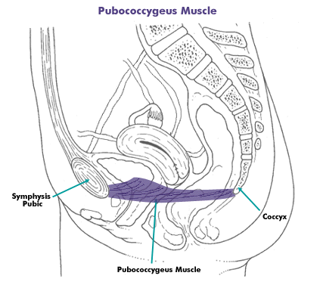
The pubococcygeus
Sends fibres to the urethra, vagina and rectum to blend with their intrinsic muscles described as
Pubourethralis
Pubovaginalis
Puborectalis

Slide 11
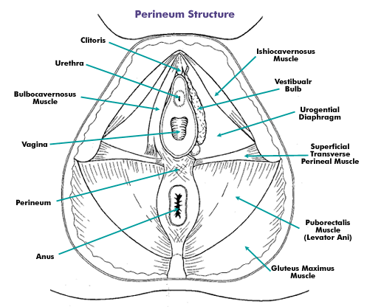
The Perineum

Slide 12
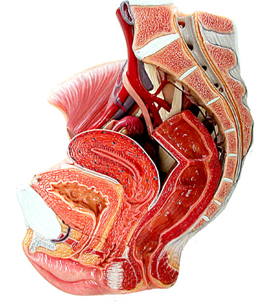
ANATOMY OF THE FEMALE GENITAL SYSTEM

Slide 13
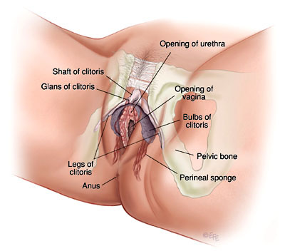
THE VULVA 1
1. Mons Veneris:
a pad of fat overlying the symphysis pubis and covered by skin & hairs.
2. Clitoris:
an erectile cavernous structure below the symphysis pubis.
formed of a small glans and two corpora cavernosa.

Slide 14
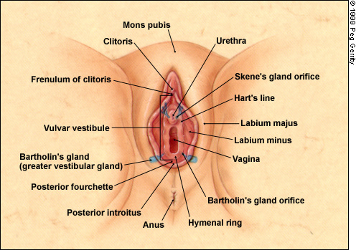
THE VULVA 2
3. Labia Majora:
The outer 2 skin folds, raised by underlying fat, and passing back from the mons veneris to the perineum. The outer skin is covered by hairs while the inner medial surface is smooth, hairless and contains sebaceous and sweat glands.
4. Labia Minora:
2 thin folds of modified skin situated medial to the labia majora.

Slide 15
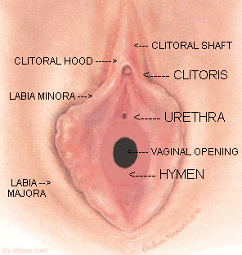
THE VULVA 3
5. The Hymen:
a membrane, situated about 2 cm from the vestibule that demarcates the external from the internal genital organs, and partially closes the vaginal orifice.

Slide 16
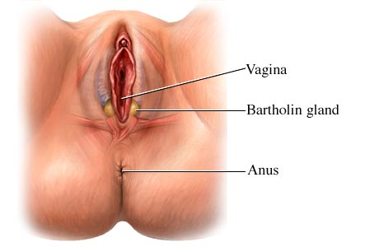
THE VULVA 4
6. Bartholin Glands: (Greater Vestibular Glands):
bilateral compound racemose glands
secrete mucus during sexual excitement
situated deep in the labia majora, at the junction of the posterior and the middle thirds
Its duct is 2 cm long and opens between the hymen and the labium minus.
7. Vestibule:
the area between the inner aspects of the labia minora and the fourchette.
Structures that open in the vestibule are:
Urethra
The Bartholin glands ducts.
The vagina.
8. Vestibular bulbs:
oblong masses of erectile tissue that lie on each side of the vaginal introitus
9. External urethral meatus:
a triangular slit in the anterior part of the vestibule below the clitoris in which the urethra opens.
10. Skene’s duct:
2 blindly ending para-urethral tubules which open in the floor of the urethra, few millimetres form the external urethral meatus.

Slide 17
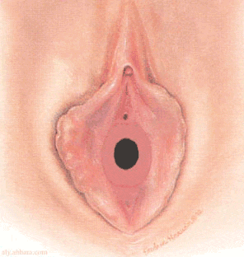
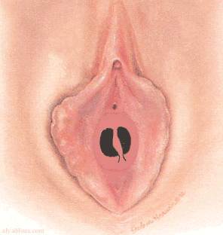
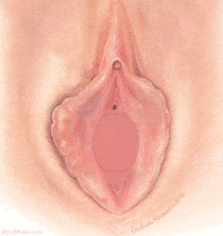
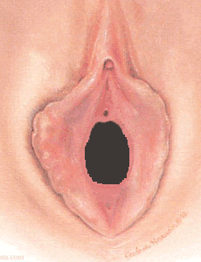
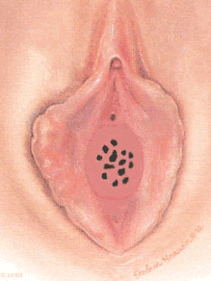
Types of hymen
Bi-perforate
Virgin
imperforate
Deflorated
Cribriform

Slide 18
Blood Supply
Arterial Supply:
Internal pudendal artery: The terminal branch of the anterior division of the internal iliac artery that ends as the dorsal artery of the clitoris.
Branches from the femoral artery, supply the anterior part.
Superficial and deep external pudendal arteries.
Venous Drainage:
The veins draining the vulva form a venous plexus from which veins accompany their corresponding arteries. The veins draining the clitoris join vaginal and vesical venous plexuses.

Slide 19
Lymphatic drainage and nerve supply
Lymphatic drainage of the vulva
From the skin and appendages, to the superficial inguinal lymph nodes, to the deep inguinal and femoral lymph nodes of which the lymph node of Cloquet drains the clitoris directly.
From the former superficial group, lymphatic channels pass to the deep pelvic nodes including the external iliac, common iliac, then para-aortic lymph nodes.
Nerve supply of the vulva
The vulva is supplied mainly from the pudendal nerve (S 2, 3 & 4).
Additional sensory nerves are supplied from the Ilio-inguinal nerve (L1), the genital branch of genito-femoral nerve (L 1,2), and the posterior cutaneous nerve of the thigh.

Slide 20
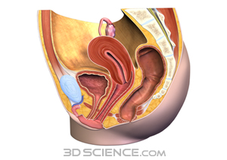
THE VAGINA
A fibromuscular tube from the vulva to the uterus forming an angle of 60° with the horizontal plane.
Length:
anterior wall is 8-9 cm
posterior wall is 10 -11 cm
Vaginal Fornices:
The cervix projects in the upper blind end of the vagina that forms a pouch (vaginal pouch) around the cervix and is divided into four fornices : two lateral, anterior and posterior (deeper) fornices.

Slide 21
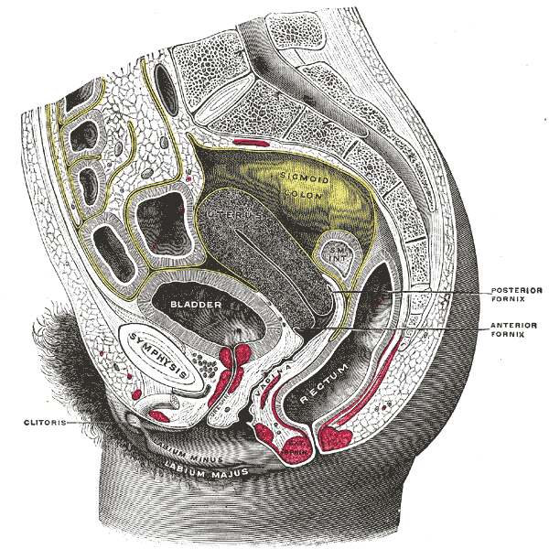
Anatomical Relations of the Vagina
Anteriorly:
Upper 1/3: trigone of urinary bladder
Lower 2/3: urethra.
Posteriorly:
Upper 1/3: peritoneum of Douglas pouch.
Middle 1/3: ampulla of rectum.
Lower 1/3: the perineal body.
Laterally:
Lower end: Bulbocavernosus muscle, vestibular bulb, and Bartholin gland.
1 cm above orifice: urogenital diaphragm
2½ cm above the orifice: levator ani muscle with the pelvic fascia above it.
The lateral fornix gives attachment, to the lower part of the cardinal ligaments.
The ureters pass through the cardinal ligaments 1 cm lateral to the vagina.

Slide 22
Vaginal Supports
Ligaments attached to the upper vagina:
Pubocervical ligament anteriorly,
Mackenrodt’s ligament laterally,
Uterosacral ligament posteriorly.
Levator ani muscles : pubo-vaginalis part
Triangular ligament, and the Perineal membrane.
Vaginal fascia: Connective tissue fascia that condenses anteriorly forming the vesico-vaginal fascia and posteriorly forming the recto-vaginal fascia.

Slide 23
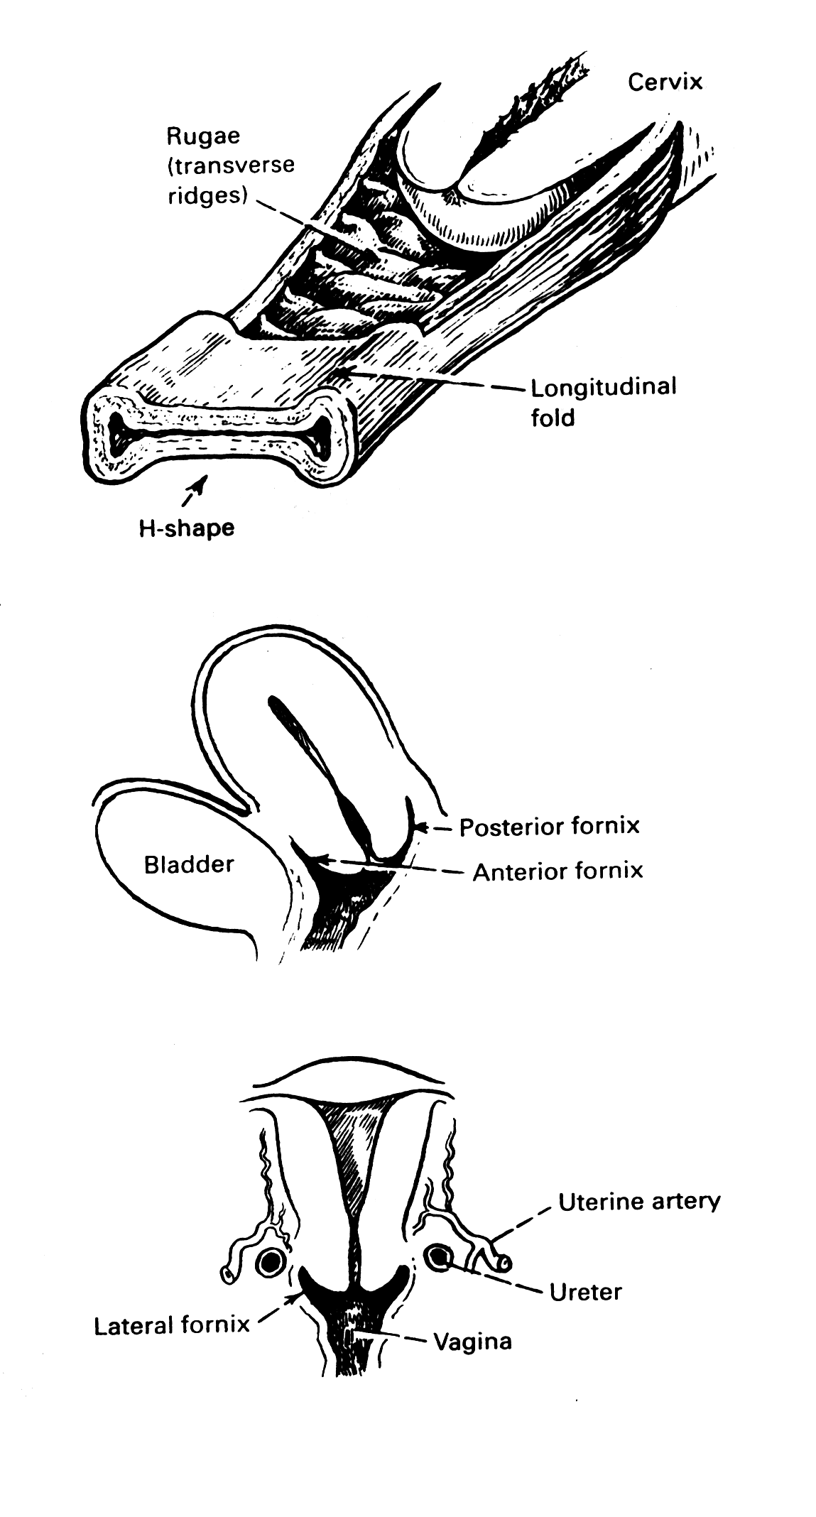
Histology of the Vagina
The cut section of the vagina is “H” shaped with approximation of the anterior to the posterior vaginal walls. It is formed of
Three layers;
mucosa, formed of squamous epithelium without glands, the
musculosa, which is fibromuscular with some fibres from the levator ani inserted into it, and the
adventitia, which is connective tissue continuous with the paracolpos.

Slide 24
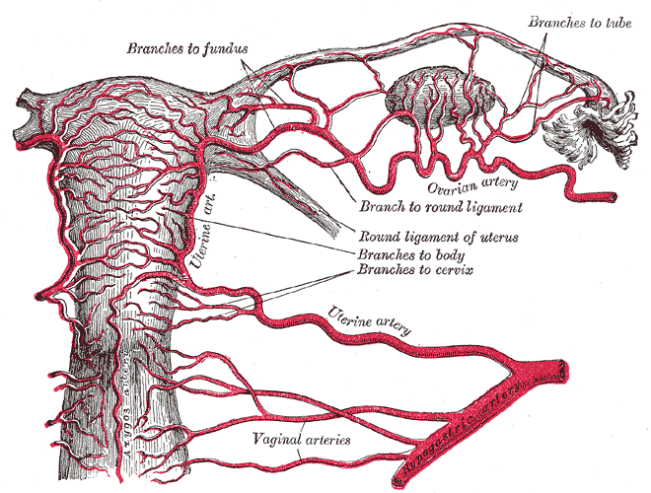
Blood Supply
Arterial supply:
The vaginal artery (from internal iliac artery)
Additional branches from:
Middle rectal artery (from internal iliac artery)
Inferior rectal artery (from the internal pudendal artery, of the internal iliac artery)
Venous drainage:
A plexus around the vagina (the vaginal plexus), drain into the internal iliac vein by veins that accompany their corresponding arteries.

Slide 25
Lymphatic drainage and nerve supply
Lymphatic drainage of the vagina
lower 1/3 drains to the inguinal lymph nodes,
upper 1/3 follows lymphatic drainage of the cervix,
middle 1/3, drains in both upper and lower directions.
Nerve supply of the vagina:
The pudendal nerve gives sensory fibres to the lower vagina.

Slide 26
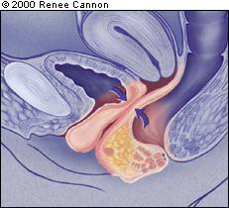
Applied anatomy 1
Vaginal Prolapse:
Weakness of the vaginal supports (ligaments, fascia and muscles) may lead to:
descent of anterior vaginal wall (cystocele or urethrocele),
descent of posterior vaginal wall (rectocele or enterocele), or
descent of the vaginal vault after hysterectomy (vault prolapse).

Slide 27
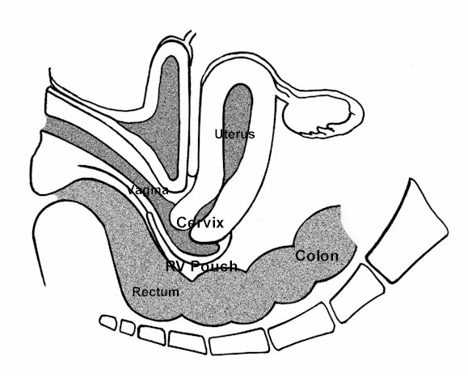
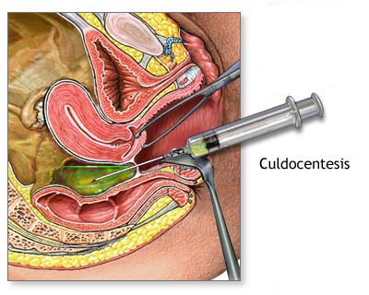
Applied anatomy 2
The posterior fornix:
offers a passage to the pouch of Douglas for performing culdoscopy, culdocentesis and for drainage of a pelvic abscess.
The lateral fornix:
The ureter lies 1-2 cm lateral to it so that it may be injured during clamping the angle of the vagina in hysterectomy operation.

Slide 28
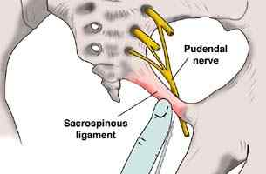
Applied anatomy 3
Pudendal nerve block:
Transvaginal injection of a local anaesthetic solution around the pudendal nerve as it passes around the ischial spine gives a local anaesthesia sufficient for minor operations on the vulva and vagina and has been used for low forceps operations in obstetrics.

Slide 29
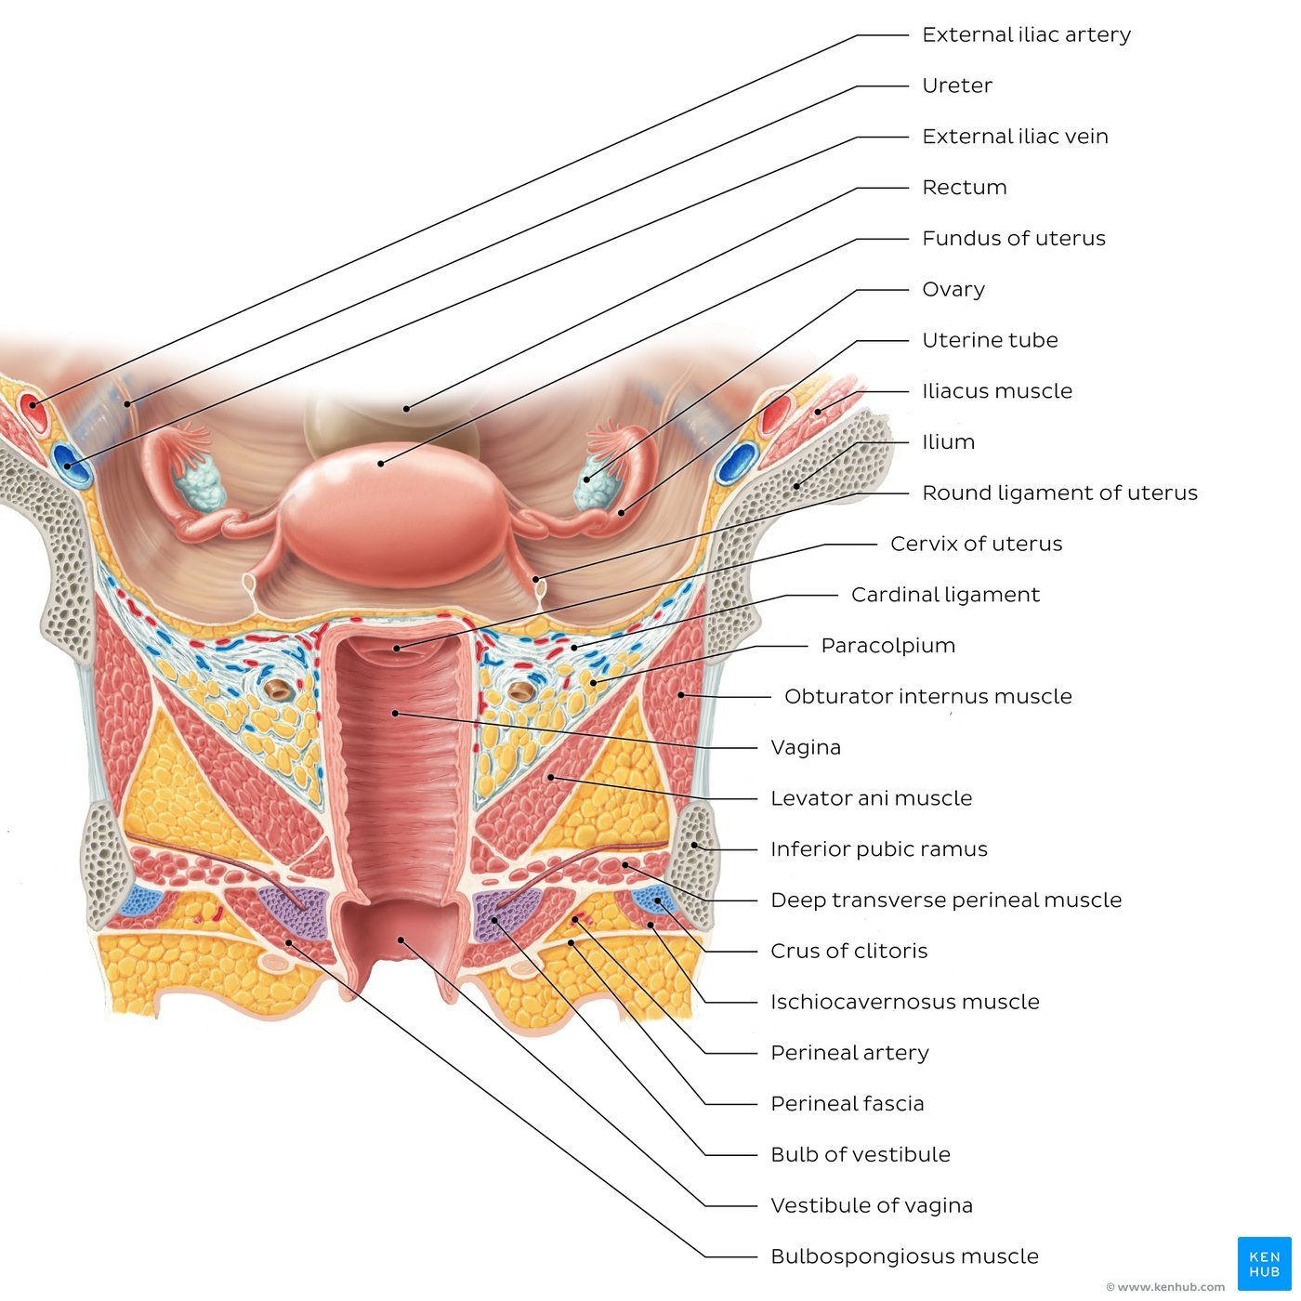
Uterus and Vagina

Slide 30
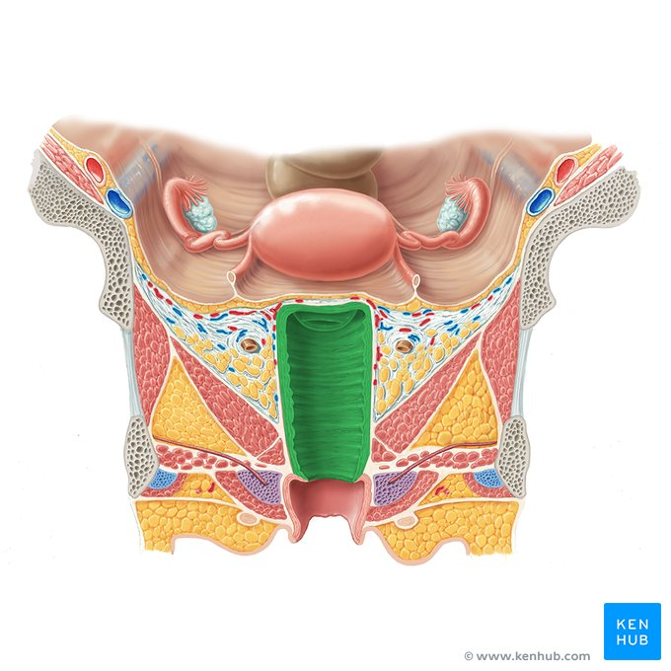
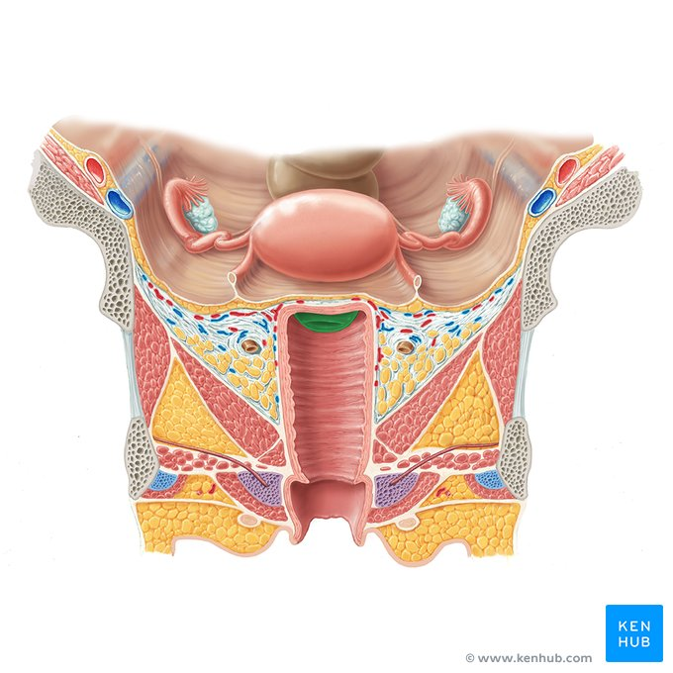
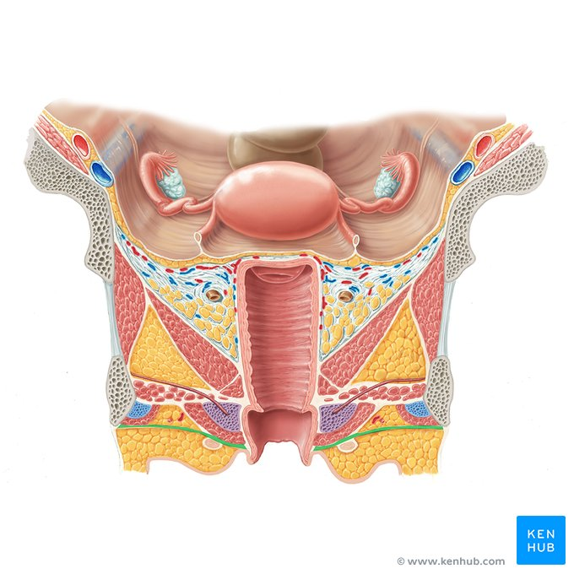

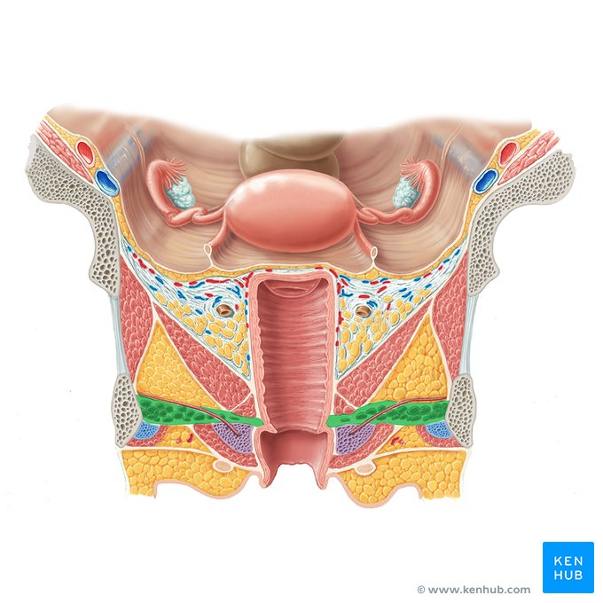
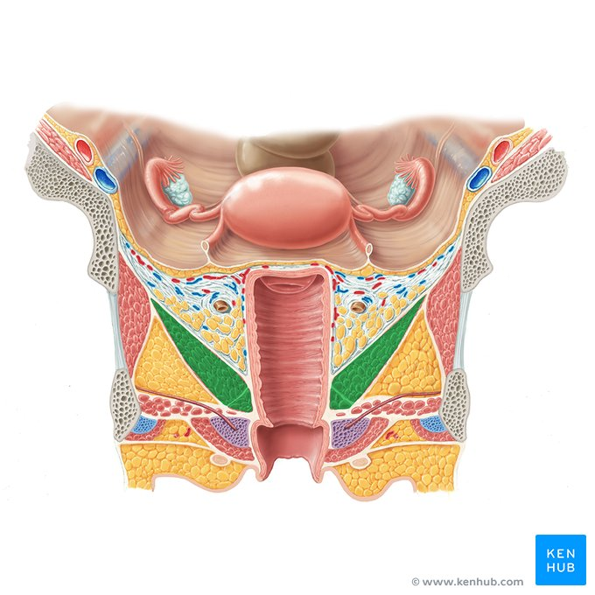
Vagina, cervix of uterus, perineal fascia, bulbospongiosus m., deep transverse perineal m., levator ani m.

Slide 31
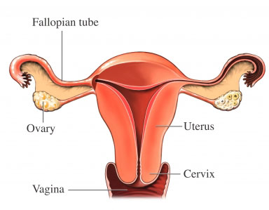
THE UTERUS
A pear shaped hollow muscular organ.
Measuring around 7.5 x 4.0 x 2.5 cm in the longitudinal, transverse, and anteroposterior diameters.
It is slightly larger in the multipara than in the nullipara.

Slide 32
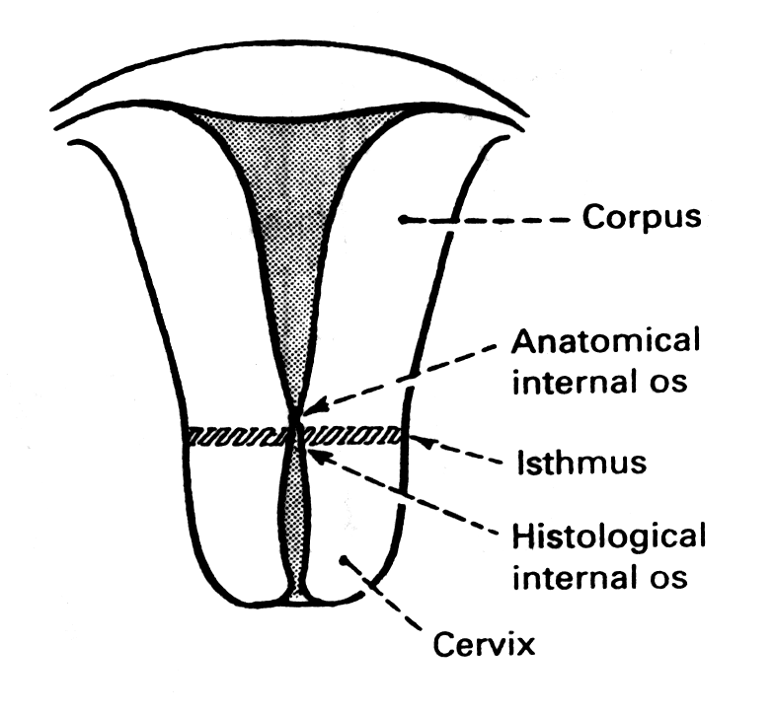
Uterus Divisions 1
The corpus uteri:
Body that lies above the internal os
Fundus lies above the insertion of the tubes.
Cornu = the area of insertion of the fallopian tubes
Three structures are attached to the cornu
round ligament anteriorly,
Fallopian tube centrally,
ovarian ligament posteriorly.

Slide 33
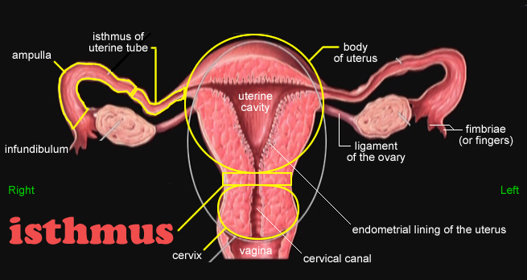
Uterus Divisions 2
2. The isthmus:
an area 4-5 mm in length that lies between the anatomical internal os above, and the histological internal os below. It is lined by low columnar epithelium and few glands.
The isthmus expands during pregnancy forming the lower uterine segment (10 cm) during the last trimester.

Slide 34
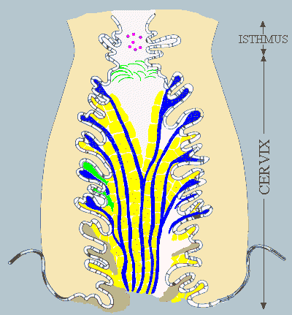
Uterus Divisions 3
3. The cervix:
The elongated lower part of the uterus
Measuring 2.5-3.0 cm.
Divided by the vaginal attachment into
supravaginal portion above
vaginal portion (portio-vaginalis) below.
The cervical canal is the cavity that communicates above with the uterine cavity at the internal os and below with the vagina at the external os.
The external os is round in nulliparas and slit shaped in multiparas.
The cervical mucosa has two ridges (anterior and posterior) from which transverse ridges radiate to form the arbor vitae uteri.

Slide 35
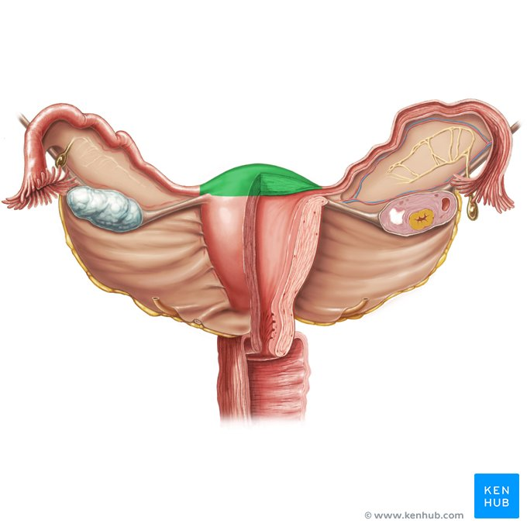
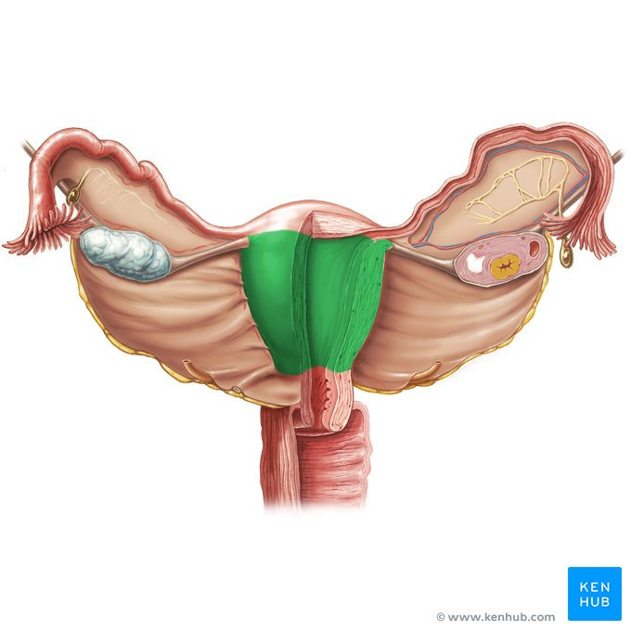
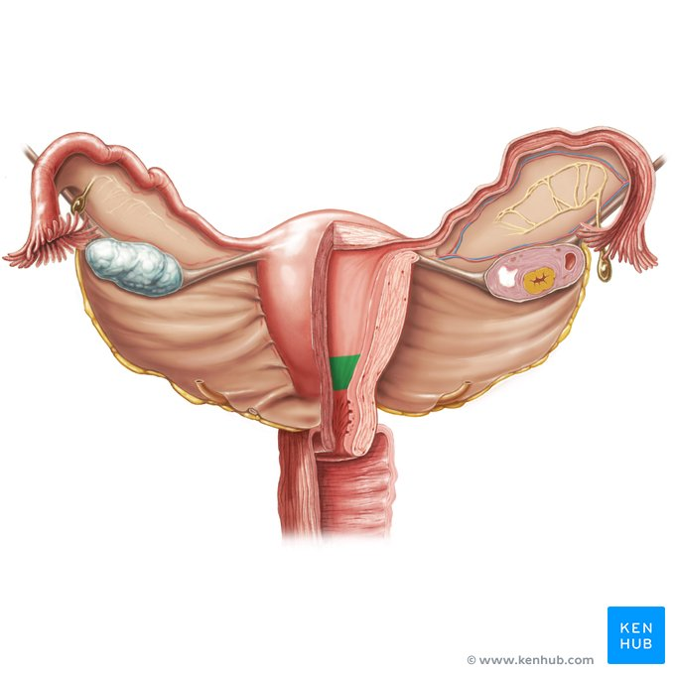
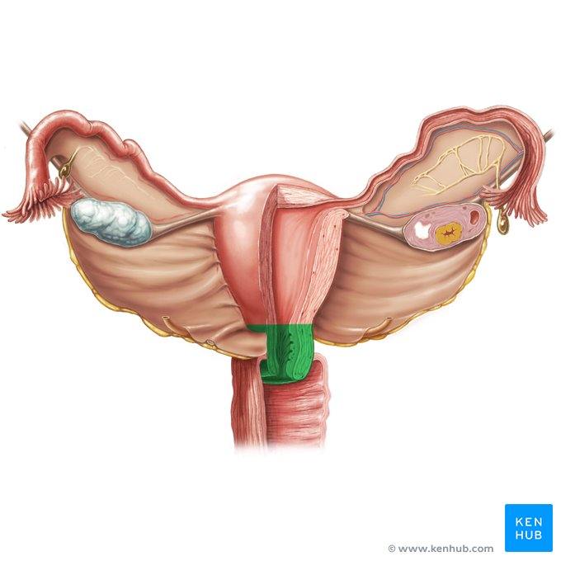
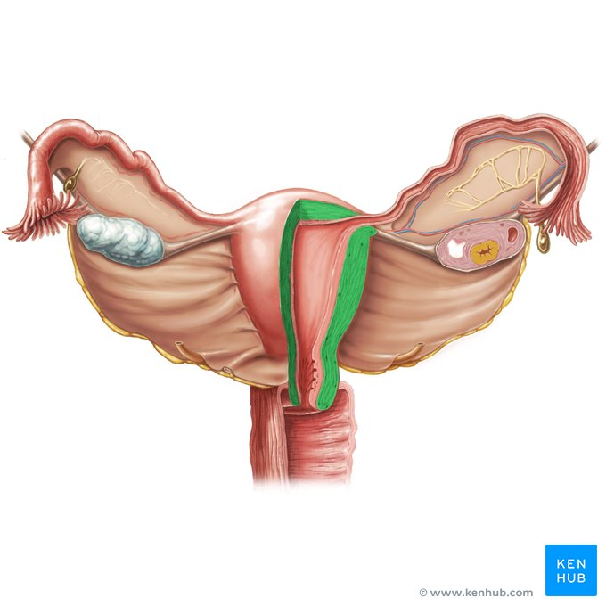
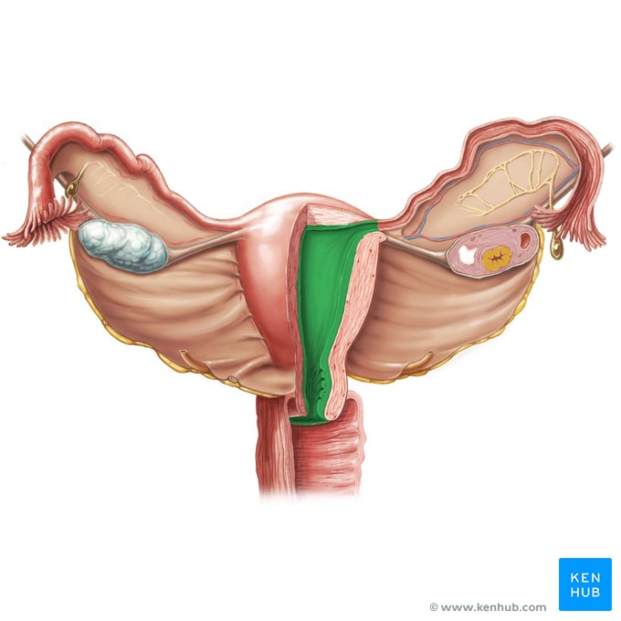
Uterine Fundus, Body, Isthmus, Cervix, Myometrium, Endometrium

Slide 36

Uterus Position
The uterus is kept in an anteverted anteflexed position (AVF), with the external os lying at the level of the ischial spines, by the support of the cervical ligaments, endopelvic fascia and pelvic floor muscles (levator ani).
Anteversion: The uterus is inclined anteriorly to axis of the vagina.
Anteflexion: The body of the uterus is bent forwards upon the cervix.

Slide 37
Relations of the Uterus Body
Anteriorly:
The bladder and vesicouterine pouch.
Posteriorly:
The pouch of Douglas.
Laterally:
The broad ligament on each side.

Slide 38
Relations of the Supravaginal cervix
Anteriorly:
Urinary bladder.
Posteriorly:
Forms the anterior wall of Douglas pouch.
Laterally:
1/2 an inch lateral to the internal os the ureter is crossed by the uterine artery (i.e. ureter below the uterine artery).
The uterosacral, cardinal, and pubocervical ligaments are attached to its posterior, lateral, and anterior surfaces respectively.

Slide 39

Histology of the Uterus 1
Three layers:
1. Endometrium: (mucosa)
2. Myometrium (musculosa)
3. The peritoneal covering or perimetrium

Slide 40

Histology of the Uterus 2
Endometrium:
Lined by simple cubical or columnar epithelium
Contains tubular glands.
Shows cyclic changes with the menstrual cycle under the influence of ovarian hormones

Slide 41

Histology of the Uterus 3
Myometrium
Three layers
outer longitudinal muscle layer
middle layer of interlacing criss-cross muscle fibres surrounding the blood vessels
inner circular muscle layer

Slide 42
Uterus - Perimetrium
Perimetrium:
Anteriorly:
firmly attached to the fundus and body till the isthmus where it becomes loose and is reflected on the superior surface of the urinary bladder forming the vesicouterine pouch.
Posteriorly:
firmly attached to the fundus, body, cervix, and posterior vaginal fornix then is reflected on the pelvic colon forming the Douglas pouch.
Laterally:
the anterior and posterior peritoneal coverings blend as the anterior and posterior layers of the broad ligaments.

Slide 43


Histology of the Cervix
Endocervix: Lined by simple columnar epithelium with compound racemose glands or crypts that are liable to chronic infection. It secretes alkaline cervical mucus.
Muscle layer: Outer longitudinal and inner circular muscles (2 layers only)
Ectocervix: Formed of stratified squamous epithelium covering the outer portion of the cervix. The junction between squamous and columnar epithelium at the external os is either abrupt or it may form a transitional zone 1-3 mm known as the transformation zone.

Slide 44


Blood Supply 1
Arterial supply:
THE UTERINE ARTERIES
Arise from the anterior division of internal iliac artery.
in the base of the broad ligament, crossing above the ureter 1/2 an inch lateral to the supravaginal cervix.
2 branches:
An ascending
A descending branch

Slide 45

Blood Supply 2
The ascending branches pass upwards in a tortuous manner parallel to the lateral border of the uterus between the 2 layers of the broad ligament to end by anastomosing with branches of the ovarian arteries near the uterine cornu.
The descending cervical branch supplies the lower cervix.

Slide 46
Blood Supply 3
Venous drainage:
Starts as a plexus between the 2 layers of the broad ligament (Pampiniform plexus) that communicate with the vesical plexus and drains into the uterine and ovarian veins.
Lymphatic drainage:
Fundus: To the para-aortic lymph nodes via ovarian vessels.
Cornu: To the superficial inguinal lymph nodes via lymphatics of the round ligament.
Body: To the internal then external iliac lymph nodes via the uterine vessels.
Isthmus: As that of the cervix.
Cervix: Two groups of lymphatics:
Primary groups: Paracervical, parametrial, obturator, internal and external iliac nodes.
Secondary groups: Common iliac, para-aortic, and lateral sacral lymph nodes.

Slide 47
Nerve supply of the uterus
The cervix and body are relatively insensitive to touch, cutting and burning.
The cervix is sensitive to dilatation and the body is sensitive to distension.
Innervations
Parasympathetic form S2,3,4
Sympathetic from:
T5 and T6 (motor)
T10, T11, T12, and L1 (sensory).
Both reach the uterus through branches of inferior hypogastric plexus.

Slide 48
THE FALLOPIAN TUBE 1
2 tortuous tubes (10 cm in length) lie in the free upper part of the broad ligament.
They blend medially with the cornu of the uterus
Laterally their free outer end curves backwards towards the ovary.
Their lumen communicates between the uterine and the peritoneal cavities.

Slide 49






Uterine tube, fimbriae, infundibulum, ampulla, isthmus, uterine ostium

Slide 50

THE FALLOPIAN TUBE 2
4 parts
1. Interstitial part (1 cm): pierces the uterine wall, very narrow, no peritoneal covering, no outer longitudinal muscles.
2. Isthmus (2 cm): straight, narrow, thick walled portion lateral to uterus.
3. Ampulla (5 cm): the widest, tortuous, thin walled outer part.
4. Infundibulum (2 cm): trumpet shaped outer end opens into the peritoneal cavity by the tubal ostium.
The ostium is surrounded by fimbriae, one of which is long and directed towards the ovary (fimbria ovarica).

Slide 51
Tubal functions
Ovum pick up, at the time of ovulation, by their free fimbrial end
Transport of the ova through the tubal lumen, by their peristaltic and ciliary movements, and
Production of secretions necessary for capacitation of the sperm and nutrition of the ova during their journey, by their lining cells.

Slide 52


Anatomical Relations
Bounded
above by loops of intestine
below by the broad ligament and its contents.
medially they blends with cornu of the uterus while
laterally they are bounded by the lateral pelvic wall.
The ovaries lie posterior and inferior to the Fallopian tubes at each side.

Slide 53

Histology of the Fallopian tubes
Mucosa (endosalpnix): Arranged into 4-5 main longitudinal ridges that give rise to subsidiary folds or plicae. It is lined by columnar partially ciliated epithelium.
Muscle layer: Outer longitudinal and inner circular involuntary smooth muscles. It is thick at the isthmus and thin at the ampulla.
Serosa (peritoneal covering): The extrauterine part is covered by peritoneum in the upper margin of the broad ligament.

Slide 54
Blood Supply & Lymphatic Drainage
Arterial supply:
branches from both the uterine artery, and the ovarian artery.
Venous drainage:
Right ovarian vein drains directly into the IVC
Left ovarian vein drains into the left renal vein.
Lymphatic drainage:
para-aortic LNs directly via ovarian lymphatics.
Nerve supply
sympathetic and parasympathetic fibres
Applied anatomy
Tubal pain is referred to the tubal points (On the lower abdominal wall 1/2 an inch above the midinguinal points).

Slide 55

THE OVARY
Almond shaped
Lying in the fossa ovarica on the lateral pelvic wall
Measuring 3 x 2 x 1 cm.
Not covered by peritoneum.
Surface is pearly white and corrugated by the effect or the monthly ovulatory activity.

Slide 56

Ovarian Attachments
Three attachments:
The mesovarium: A peritoneal fold that suspends the ovary to the back of the broad ligament.
The infundibulopelvic ligament: suspends the upper pole of the ovary to the lateral pelvic wall and carries the ovarian vessels, nerves and lymphatics.
The ovarian ligament: attaches the lower pole to the cornu of the uterus.

Slide 57





Suspensory ligament of ovary, proper ovarian ligament, uterosacral ligament, broad ligament of uterus, mesovarium

Slide 58

Anatomical Relations
The ovary is bounded
medially by the Fallopian tube,
laterally by the lateral pelvic wall.
superiorly and anteriorly it is surrounded by the small intestine
inferiorly by the ovarian fossa where the ureter and the internal iliac vessels pass.

Slide 59
Histology of the Ovary 1
The ovary is subdivided into Cortex, Medulla, and Hilum.
The Medulla: The central core of the ovary surrounded by the cortex and continuous with the hilum. It is formed of connective tissue.
The Cortex: The outer active part of the ovary that produces hormones and oocytes. Formed of:
The surface epithelium: of cuboidal cells, called the germinal epithelium, covering the free surface of the ovary
CT stroma: Composed of dense CT containing the oocytes. It is condensed on the surface to form the tunica albuginea.
The Hilum: Is the site of attachment of the mesovarium that carries blood vessels, nerves and lymphatics entering and leaving the ovary.

Slide 60

Histology of the Ovary 2

Slide 61
Ovary - Blood Supply and Lymphatic Drainage
Arterial supply:
Ovarian artery: Arises from the aorta at the level of L2 and passes through the infundibulopelvic ligament.
Ovarian branch from the uterine artery which anastomose with the ovarian vesels at the broad ligament.
Venous drainage:
The ovarian veins accompany the arterial supply and join with the pampiniform plexus of veins and the uterine vein.
Lymphatic drainage:
to the para-aortic LNs via the ovarian vessels.
Nerve supply
insensitive except to squeezing on P.V examination.
sympathetic and parasympathetic nerves (T10 and T11) through the preaortic plexus that accompany the ovarian vessel.

Slide 62

Ovarian Artery - Vein
Ovarian
Artery and Vein

Slide 63

PELVIC PART OF THE URETER 1
The ureter is a narrow muscular tube, about 25 cm in length.
It runs retroperitoneally from the kidney to the urinary bladder.
At the pelvic inlet: The ureter enters the pelvis above the bifurcation of the common iliac artery anterior to the sacroiliac joint.
In the pelvis: It runs downwards lying in front of the internal iliac artery.

Slide 64

PELVIC PART OF THE URETER 2
At the base of the broad ligament it runs medially and forwards through the parametrium till it reaches about 1 cm lateral to the supravaginal cervix where it passes below and at the right angle to the uterine artery.
The ureter then passes forwards through the ureteric canal in the upper part of the cardinal ligament, closely related to the lateral vaginal fornix, to enter the trigone of the urinary bladder.

Slide 65
Blood supply of the ureter
branches from the
internal iliac artery
uterine artery
inferior vesical artery
vaginal artery.

Slide 66
Applied anatomy – Ureteric injuries
During Hysterectomy the ureter may be injured at the following sites:
During clamping of the infundibulopelvic ligament as it passes below the ovarian vessels in the lateral pelvic wall.
During clamping of the uterine arteries as it passes below the uterine artery 1 cm lateral to the cervix
During clamping the vaginal angles and the parametrium 1.0 cm lateral to vaginal vault.

Slide 67

UTERINE AND CERVICAL LIGAMENTS
Broad ligament
Round ligament
Ovarian ligament

Slide 68

THE BROAD LIGAMENT
The broad ligament is a double sheet of peritoneum that extends from the lateral wall of the uterus to the lateral pelvic wall.
Its outer upper part forms the infundibulopelvic ligament in which the ovarian vessels traverse their way to the ovary.

Slide 69

Contents of the Broad Ligament
Round ligament
Ovarian vessels
Uterine vessels
Ureter
Parametrial lymphatics and lymph nodes
Sympathetic and parasympathetic nerves
Parametrial pelvic cellular tissue and fascia
Embryological remnants of the Wolffian ducts
Hydatid cyst of Morgagni
Koblet’s tubules
Epoophoron
Paroophoron Gartner’s duct

Slide 70

The Round Ligament
A fibromuscular ligament attached to the uterine cornu.
Runs downwards and forwards in between the two leafs of the broad ligament to enter the inguinal canal via the internal inguinal ring and comes out of it at the external inguinal ring to be inserted in the upper part of the labium majus.
It pulls the uterus forwards and help keeping it in an anteverted position.

Slide 71

The ovarian ligament
A fibromuscular ligament that attaches the inner lower pole of the ovary to the cornu of the uterus.
It plays no role in pelvic support of the uterus.

Slide 72

THE CERVICAL LIGAMENTS
The cervical ligaments are condensed thickening of the pelvic cellular tissue, that lies between the pelvic peri­toneum above and the levators ani below and radiates outwards from the cervix to reach the pelvic walls.
They act as the chief support of the uterus and pelvic structures

Slide 73
Three Pairs of Ligaments
Mackenrodt’s ligaments (The cardinal ligaments of the cervix): spread out on either side from the lateral surface of the cervix and vagina, in a fan-shaped manner, and are inserted in the lateral pelvic wall.
Utero-sacral ligaments: From the cervix and vagina, backwards surrounding the rectum and below the utero-sacral folds of peritoneum, to become inserted in the third piece of the sacrum.
Pubo-cervical ligaments: extend from the anterior surface of the cervix and vagina, forwards beneath the bladder and surrounding the urethra, to the posterior surface of the pubis.

Slide 74

Fetus in utero
While in the uterus, the fetus is surrounded by a thin double layered membrane called the amniotic sac.
The inner layer (closer to the fetus) is also known as the amnion, while the outer layer (closer to the uterus) is also known as the chorion.
The amniotic sac is filled with amniotic fluid that surrounds and bathes the fetus during development.
The fetus is connected to the placenta via the umbilical cord.
The umbilical cord has two umbilical arteries that carry the deoxygenated blood from the fetus. In contrast, a single umbilical vein carries oxygenated blood, rich in nutrients from the mother to the fetus.

Slide 75

Cross - section of the placenta
At the beginning of the fetal period, the placenta has two components: a fetal portion, formed by the chorion frondosum, and a maternal portion, formed by the decidua basalis.
On the fetal side, the placenta is bordered by the chorionic plate. On its maternal side, it is bordered by the basal decidua.
The placenta is the meeting point of two circulatory systems: fetal circulation and maternal circulation.
The maternal component of the placenta contains maternal arteries and veins that feed into the intervillous spaces. On the opposite side, the umbilical arteries and veins form a tree-like structure within the intervillous space. Here, the fetal and maternal blood comes into close contact separated only by a thin membrane, called the placental membrane.

Slide 76

questions

